Slide 1
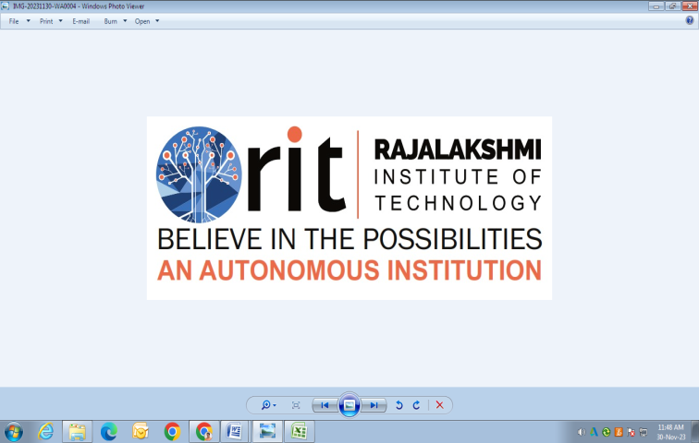
DEPARTMENT OF
CSE (ARTIFICIAL INTELLIGENCE AND MACHINE LEARNING)
ACADEMIC YEAR 2025 - 2026
SEMESTER III
ARTIFICIAL INTELLIGENCE LABORATORY
MINI PROJECT REVIEW
<TITLE OF THE PROJECT>
REGISTER NUMBER | 2117240030019
NAME | BHARGAVA SHETTY
YEAR | 2nd
SECTION | A
FACULTY IN-CHARGE | Mrs. M. Divya

Slide 2
PROBLEM STATEMENT
Lack of real-time data analysis and predictive capability.
Some blood types are in short supply, others go unused.
Inefficient communication with donors and hospitals.
No centralized platform for donor and hospital data.
Difficulty in forecasting blood and organ demand accurately.
Delays in matching donors with recipients during emergencies.
Manual tracking of donor records leads to errors and inefficiency.
Donor awareness and participation are inconsistent.
Limited ability to plan donation drives based on demand trends.
No automated system to notify donors during urgent requirements.

Slide 3
THEORETICAL BACKGROUND
AI-Based Blood Donation Management System
Uses AI & Machine Learning for blood donation management.
Improves prediction, matching, and decision-making.
AI in Blood Donation
Predicts blood demand using historical data.
Matches donors with recipients automatically.
Handles multiple input parameters (blood type, age, location, donation history).
Decision Tree Algorithm
Divides data into smaller subsets based on attributes.
Interpretable and easy to implement.
Predicts categorical outcomes: donor eligibility, blood shortages.
Random Forest Algorithm
Ensemble of multiple Decision Trees.
Reduces overfitting and improves accuracy.
Suitable for complex datasets with multiple influencing factors.
Algorithm Justification
Simple, interpretable, scalable.
Handles categorical data efficiently.
Fast training and prediction for real-time use.
Random Forest improves accuracy and robustness.

Slide 4
IMPLEMENTATION AND CODE
Link to code in Git-hub Repository
List | Git-hub Repository Links
Implementation of Code Link | https://github.com/Srirangam1107/AI-mini-project/blob/3a5ceb5794d8a4184638c75b888f7f81700d7593/AI%20mini%20project%20binsu.py
Word Document Report Link | https://github.com/Srirangam1107/AI-mini-project/blob/61b3ffc0a46aba9b743439ea3c552c8e6731bd71/bhargava%20shetty.docx
PPT Link

Slide 5
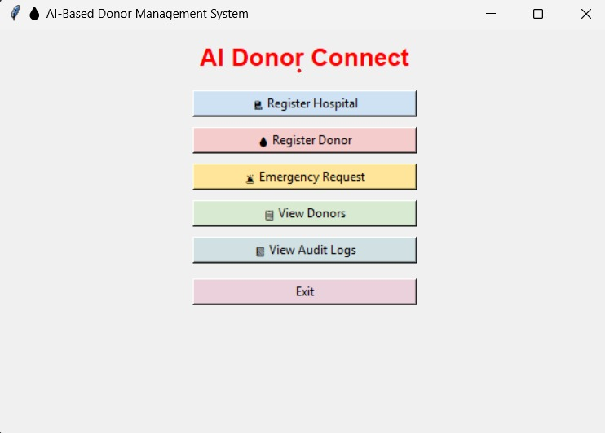
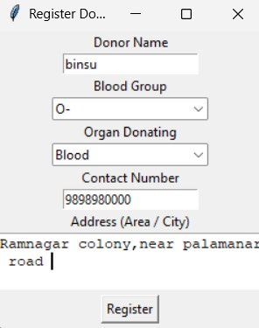
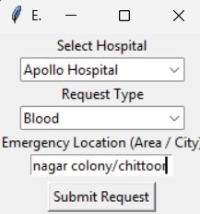
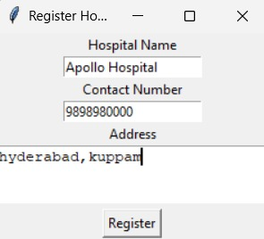
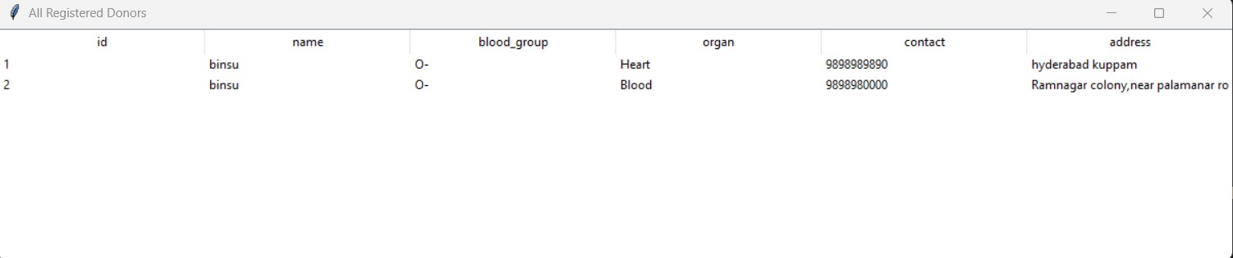
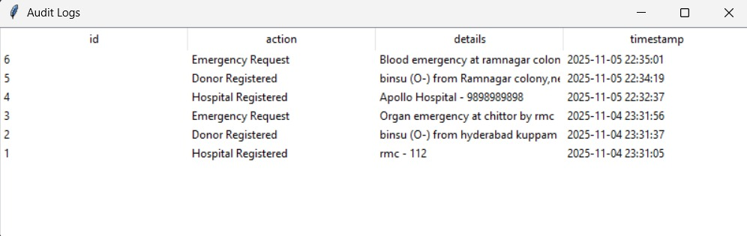
OUTPUT AND RESULTS

Slide 6
OUTPUT and RESULT
The output of the AI-Based Blood Donation System shows whether a donor is eligible to donate blood based on the input features such as age, last donation date, health status, and blood group. The system uses a Decision Tree algorithm, which applies a set of decision rules learned from historical data to make this prediction.

Slide 7
REFERENCES
Jefri Junifer Pangaribuan & Alexander Putra, “Blood Donation Classification with Decision Tree Method using C4.5 Algorithm,” International Journal of Multidisciplinary Approach Research and Science (IJMARS). Available online: https://risetpress.com/index.php/ijmars/article/view/961 (risetpress.com)
Nahashon Kiarie, Amos Chege Kirongo & Mary Mwadulo, “A systematic review of predictive blood donor retention models,” African Journal of Science, Technology and Social Sciences, Vol. 2, No 2 (2023–24). Available: https://journals.must.ac.ke/index.php/AJSTSS/article/view/206 (journals.must.ac.ke)
Oded Z. Maimon & Lior Rokach, Data Mining with Decision Trees: Theory and Applications (2nd Edition). World Scientific Publishing Company. Available: https://mitpressbookstore.mit.edu/book/9789814590075 (mitpressbookstore)
“Decision Tree,” article on GeeksforGeeks (online tutorial explaining decision tree algorithm fundamentals). Available: https://www.geeksforgeeks.org/machine-learning/decision-tree/ (GeeksforGeeks)
Jaspreet Kaur Bhatoye, Indresh Verma & Arundhati Guha Thakurta, “How AI is Keeping Blood Donation in Check,” Gerontology & Geriatrics Studies (2023). Available: https://crimsonpublishers.com/ggs/fulltext/GGS.000684.php (crimsonpublishers)

